Slide 1
CS 5402 Introduction to Data Mining
Clustering
v.1
Perry B. Koob, koobp@mst.edu

Slide 2
What we are going to learn.
Clustering
k-Means

Slide 3
Clustering - Classic Example
"Alexander joins forces with James Madison and John Jay to write a series of essays Defending the new United States constitution Entitled The Federalist papers The plan was to write a total of twenty-five essays The work divided evenly among the three men In the end, they wrote eighty-five essays, in the span of six months John Jay got sick after writing five James Madison wrote twenty-nine Hamilton wrote the other fifty-one"
-Hamilton: An American Musical
https://blog.jonlu.ca/posts/the-federalist-papers-author-identification-through-k-means-clustering

Slide 4
Clustering - Classic Example “Federalist Papers”
"Alexander joins forces with James Madison and John Jay to write a series of essays Defending the new United States constitution Entitled The Federalist papers The plan was to write a total of twenty-five essays The work divided evenly among the three men In the end, they wrote eighty-five essays, in the span of six months John Jay got sick after writing five James Madison wrote twenty-nine Hamilton wrote the other fifty-one"
-Hamilton: An American Musical
In reality the authorship of 12 of them are in dispute.
https://blog.jonlu.ca/posts/the-federalist-papers-author-identification-through-k-means-clustering

Slide 5
Clustering
Clusters is the grouping of like items together while separating them from dissimilar items.
It can be Supervised, Semi-Supervised, and Unsupervised.
Iterative Distance Based Clustering
Hierarchical Clustering
Incremental Clustering
Density Based Clustering
Evolutionary Clustering
https://scikit-learn.org/stable/modules/clustering.html

Slide 6
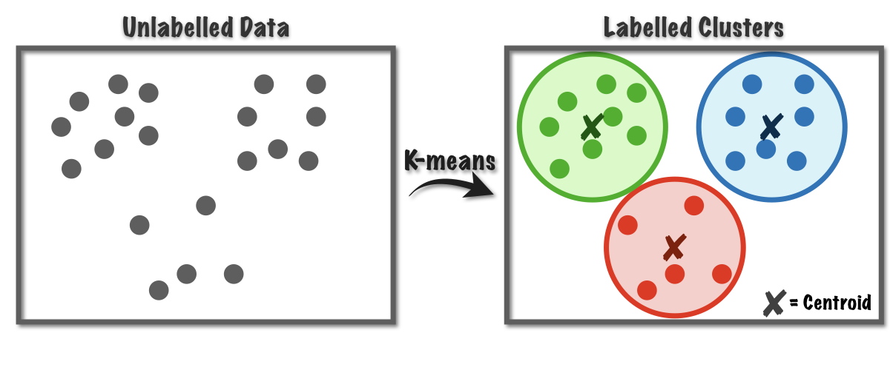
Clustering - Iterative Distance Based Clustering
Clustering like items based on their distance from the cluster center (centroid). Centroids are determined based on an iterative process.
Example: k-Means
https://towardsdatascience.com/k-means-a-complete-introduction-1702af9cd8c

Slide 7
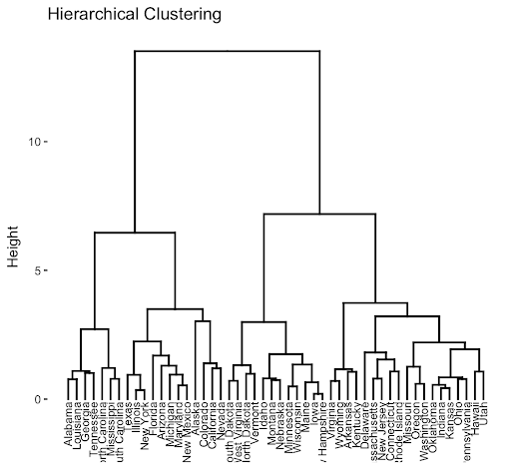
Clustering - Hierarchical Clustering
Top-down method starts by forming 1 clusters, then evaluate the case for splitting into more (divisive).
Bottom-up method starts with 1 cluster per example, then evaluate the case for joining clusters (agglomerative).
http://www.sthda.com/english/articles/28-hierarchical-clustering-

Slide 8
Clustering - Hierarchical Clustering
Top-down method starts by forming 1 clusters, then evaluate the case for splitting into more (divisive).
Bottom-up method starts with 1 cluster per example, then evaluate the case for joining clusters (agglomerative).
http://www.sthda.com/english/articles/28-hierarchical-clustering-

Slide 9
Clustering - Hierarchical Clustering
Top-down method starts by forming 1 clusters, then evaluate the case for splitting into more (divisive).
Bottom-up method starts with 1 cluster per example, then evaluate the case for joining clusters (agglomerative).
http://www.sthda.com/english/articles/28-hierarchical-clustering-

Slide 10
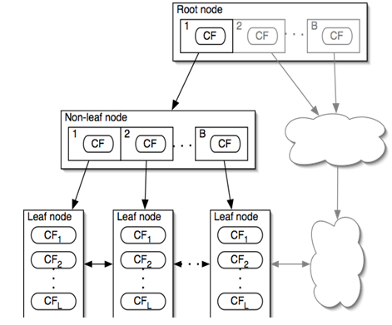
Clustering - Incremental Clustering
We start with a one example cluster, then add one example at a time developing a tree of clustering features.
When branches reach a certain size or threshhold or branching factor.
Example: BIRCH
https://towardsdatascience.com/machine-learning-birch-clustering-algorithm-clearly-explained-fb9838cbeed9

Slide 11
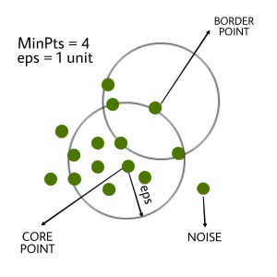
Clustering - Density Based Clustering
We randomly select location to start with and then group examples together that are within close proximity to dense clusterings. We may join them together if they get close enough.
Example: DBSCAN
https://www.geeksforgeeks.org/dbscan-clustering-in-ml-density-based-clustering/

Slide 12
Clustering - Evolutionary Computing
These are techniques that are designed to mimic biological evolution.
Sometimes called Swarm Intelligence.
Example: Artificial Bee Colony (ABC)

Slide 13
k-Means Clustering
Idea from Hugo Steinhaus in 1956
Algorithm was first proposed by Stuart Lloyd of Bell Labs in 1957
Used by James MacQueen in 1967
K-Means Clustering is an unsupervised Iterative Distance Based Clustering.
Takes numeric values, interval and ratio, and groups them based on their distance from a center-point or centroid.

Slide 14
k-Means Clustering Parameters
Number of Clusters.
To use k-Means Clustering you need to know the number of clusters before hand.
You may need to use other methods to determine the number of clusters, or you can hyper-parameterize it.

Slide 15
k-Means Clustering - Steps
Set a number of clusters, k, that the data will be clustered into.
Randomly select, k points to be the center of the clusters.
Calculate the distance between the center of the clusters and all examples.
Put examples in the clusters based on their proximity to the centers of the clusters.
Determine a new cluster center based on where the members of the cluster.
Repeat Steps 3 through 5 until the clusters centers don’t change.

Slide 16
k-Means Clustering - Convergence
http://shabal.in/visuals/kmeans/5.html

Slide 17
k-Means Clustering

Slide 18
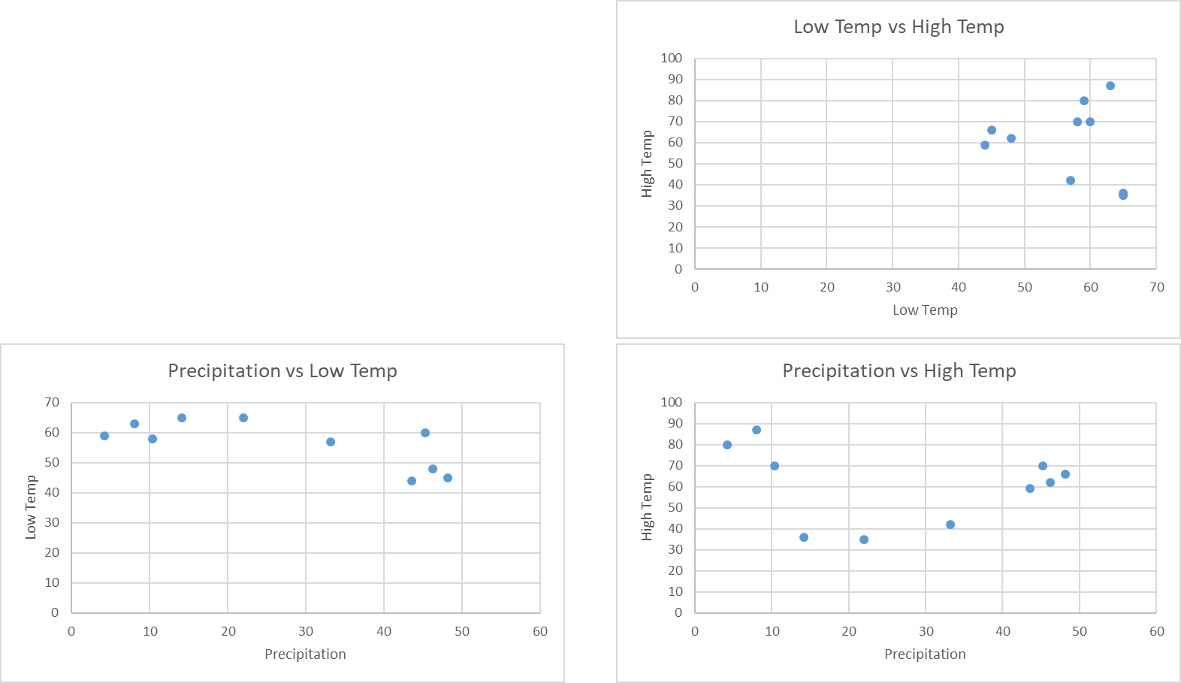
k-Means Clustering

Slide 19
k-Means Clustering
We need to normalize the data. Otherwise the attributes with larger magnitudes will overpower the distance function.

Slide 20
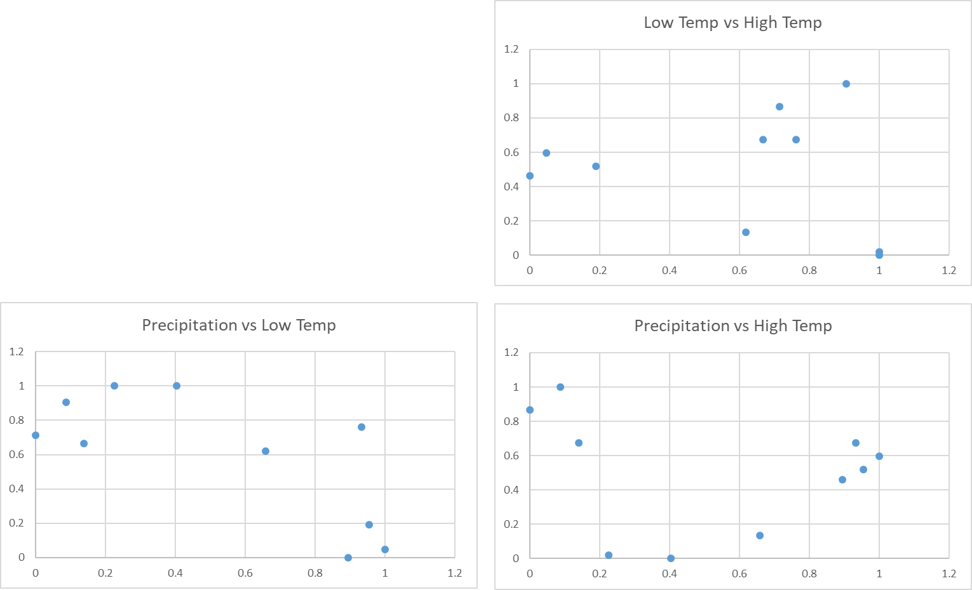
k-Means Clustering

Slide 21
k-Means Clustering
We need to pick the number of clusters we want. I will pick 2.

Slide 22
k-Means Clustering
We randomly pick 2 of our examples to be the initial centers of our clusters.

Slide 23
k-Means Clustering

Slide 24
k-Means Clustering
Now we calculate the distances between each example and each centroid. We are going to use the Euclidean distance.

Slide 25
k-Means Clustering

Slide 26
k-Means Clustering
Now we assign each example to a class based on the centroid that is the closest.

Slide 27
k-Means Clustering

Slide 28
k-Means Clustering

Slide 29
k-Means Clustering
Now we adjust the centroid to the center of the assigned data points.

Slide 30
k-Means Clustering
Now we adjust the centroid to the center of the assigned data points.

Slide 31
k-Means Clustering

Slide 32
k-Means Clustering
We continue to iterate until we reach convergence.
Which means our Centroids no longer moves, and cluster membership does not change.

Slide 33
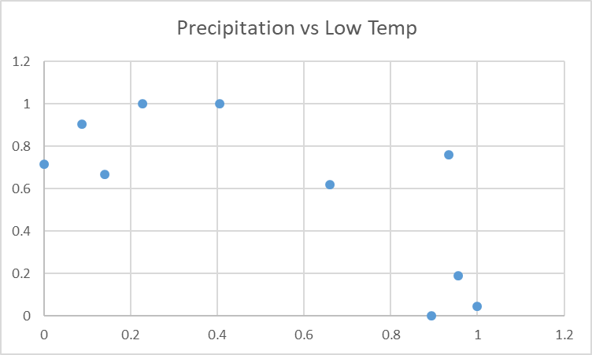
k-Means Clustering

Slide 34
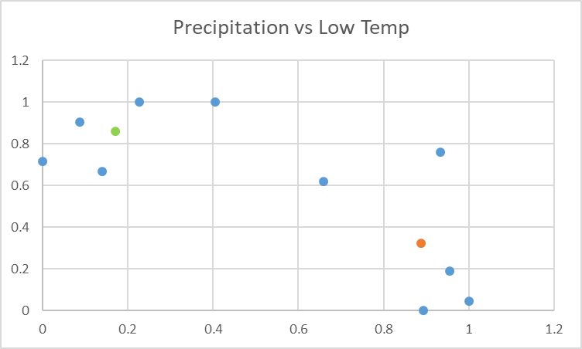
k-Means Clustering

Slide 35
k-Means Clustering
Cluster 1
Cluster 2
Centroids

Slide 36
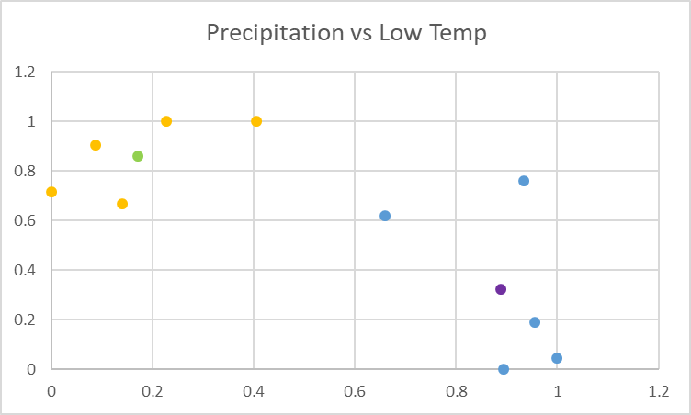
k-Means Clustering

Slide 37
k-Means Clustering
Cluster 1
Cluster 2
Centroids

Slide 38
k-Means Clustering
This of course means that if you have a large number of examples the calculations can take a long time. Just like k-Nearest Neighbor.
Just like k-Nearest Neighbor, this can be sped up using kD-trees.

Slide 39
k-Means Clustering - Python
import numpy as np
import pandas as pd
import matplotlib.pyplot as plt
from sklearn.cluster import KMeans
from sklearn import preprocessing
data = pd.read_csv("..\\src-data\\k-means.csv")
norm = preprocessing.normalize(data[['precipitation','lowtemp','hightemp']])
norm = pd.DataFrame(norm, columns = ['precipitation','lowtemp','hightemp'])

Slide 40
k-Means Clustering - Python
array([[0.47987893, 0.56742656, 0.65938659], [0.14049444, 0.70299005, 0.66143082]])
kmeans = KMeans(n_clusters=2, random_state=0).fit(norm)
data['norm'] = kmeans.labels_
kmeans.labels_
array([0, 0, 0, 1, 1, 1, 1, 0, 0, 1])
centroids = kmeans.cluster_centers_
centroids
array([[0.47987893, 0.56742656, 0.65938659],
[0.14049444, 0.70299005, 0.66143082]])

Slide 41
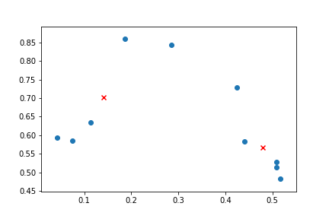
k-Means Clustering - Python
plt.scatter(norm['precipitation'], norm['lowtemp'])
plt.scatter(centroids[:,0], centroids[:,1], marker="x", color='r')

Slide 42
k-Means Clustering - R
fulldata <- read.csv(file = '../src-data/k-means.csv',stringsAsFactors=TRUE)
data <- fulldata[,c('precipitation','lowtemp','hightemp')]
normalize <- function(x) {
return ((x - min(x)) / (max(x) - min(x)))
}
data$precipitation <- normalize(data$precipitation)
data$lowtemp <- normalize(data$lowtemp)
data$hightemp <- normalize(data$hightemp)

Slide 43
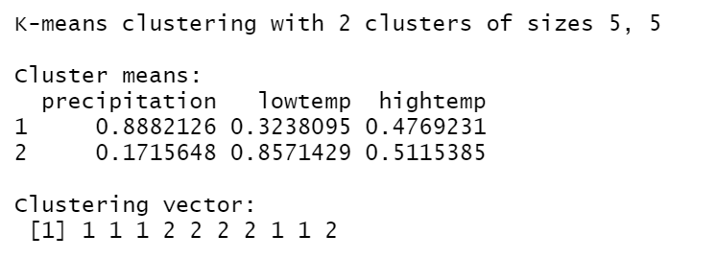
k-Means Clustering - R
set.seed(314)
model <- kmeans(data,2)
model
cbind(fulldata,model$cluster)

Slide 44
Results from all Three Methods
1 1 1 2 2 2 2 1 1 2
Manual 1, 1, 1, 2, 2, 2, 2, 1, 1, 2
Python 0, 0, 0, 1, 1, 1, 1, 0, 0, 1
R 1, 1, 1, 2, 2, 2, 2, 1, 1, 2

Slide 45
What would happen if we chose a k of 3?

Slide 46
What would happen if we chose a k of 3?
kmeans = KMeans(n_clusters=3, random_state=0).fit(norm)
data['norm'] = kmeans.labels_
kmeans.labels_
centroids = kmeans.cluster_centers_
centroids
plt.scatter(norm['precipitation'], norm['lowtemp'])
plt.scatter(centroids[:,0], centroids[:,1], marker="x", color='r')
plt.savefig('norm with 3 centers.png')

Slide 47
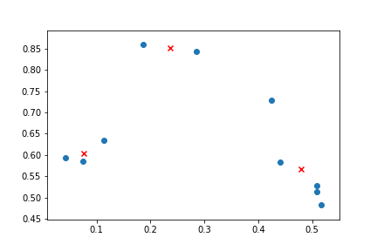
What would happen if we chose a k of 3?

Slide 48
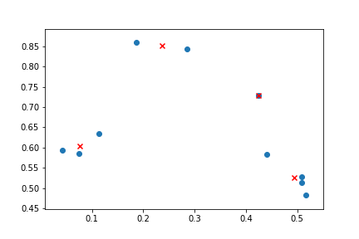
What would happen if we chose a k of 4?

Slide 49
What we covered.
Clustering
k-Means

Slide 50
What to learn more?
For Clustering take Comp Eng 6330/
Elec Eng 6830/Sys Eng 6214/Comp Sci 6405/Stat 6239
or
IST 6443.

Slide 51
References
Ester, M., Kriegel, H. P., Sander, J., & Xu, X. (1996, August). A density-based algorithm for discovering clusters in large spatial databases with noise. In Kdd (Vol. 96, No. 34, pp. 226-231).
Miranda, L. (2016). Hamilton: an American musical. In J. McCarter (Ed.), Hamilton: the revolution. New York: Grand Central Publishing.
Shmueli, G., Bruce, P. C., Yahav, I., Patel, N. R., & Lichtendahl Jr, K. C. (2017). Data mining for business analytics: concepts, techniques, and applications in R. John Wiley & Sons.
Witten, I. H., Frank, E., Hall, M. A., & Pal, C. J. (2016). Data Mining: Practical Machine Learning Tools and Techniques.

